Slide 1
Photomicrographs of Plant foods
Cranberry
Permission to reproduce original photomicrographs used to make this collection may be obtained from
Dr. David O. Norris at
david.norris@colorado.edu

Slide 2
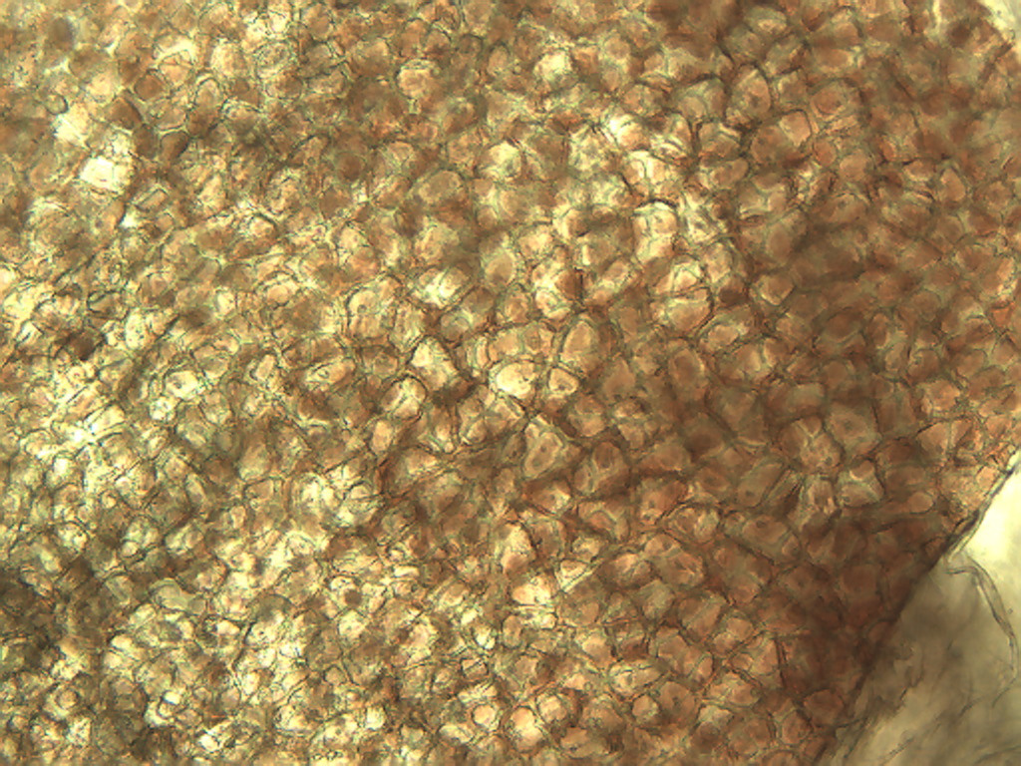
Notes:
147. Vaccinium macrocarpon Aiton Cranberry. Skin epidermal cells, 10X.

Slide 3
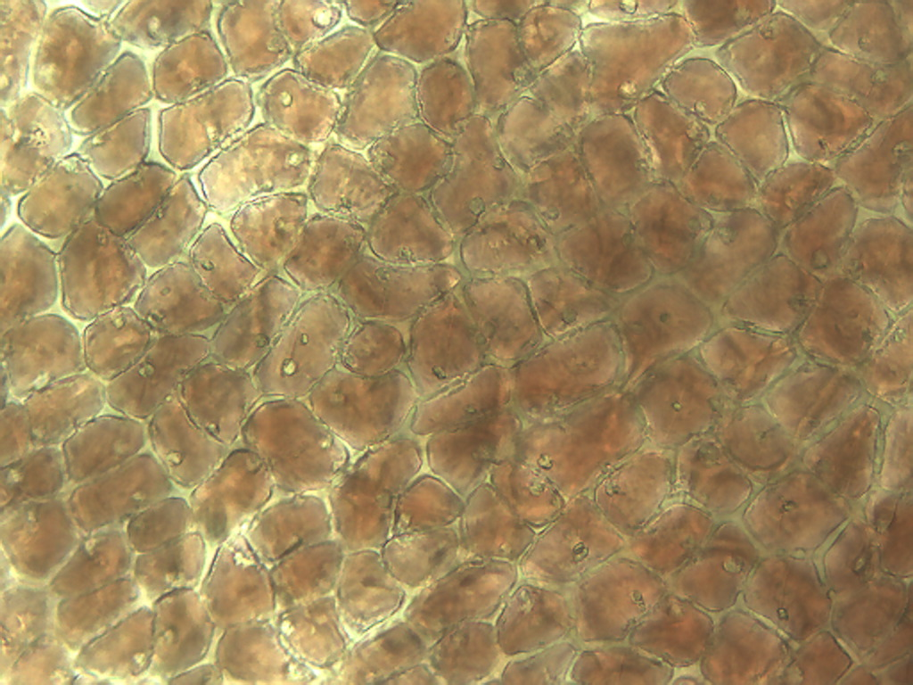
Notes:
148. Cranberry. Pigmented skin epidermal cells, 25X.

Slide 4
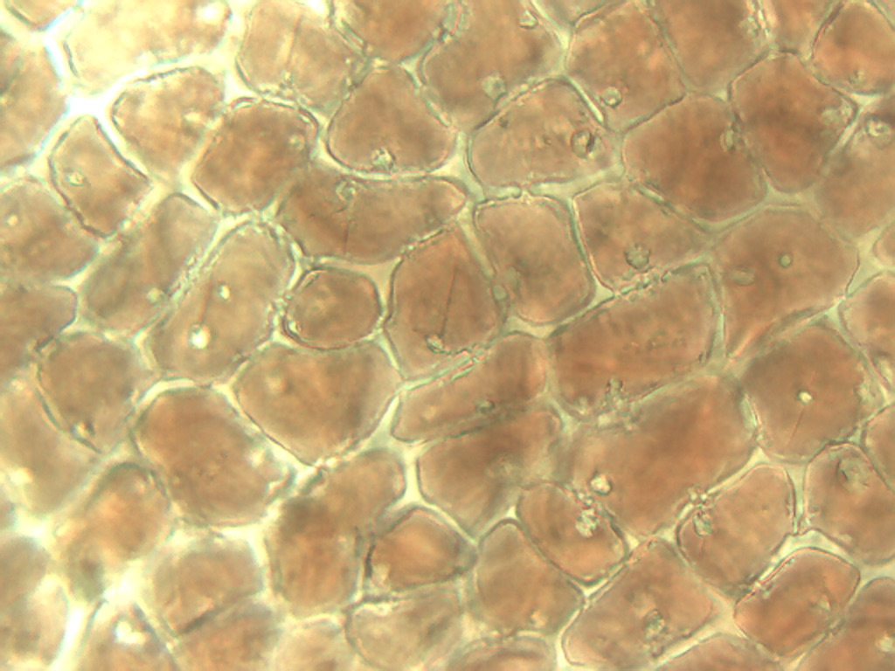
Notes:
149. Cranberry. Skin epidermal cells, 40X.

Slide 5
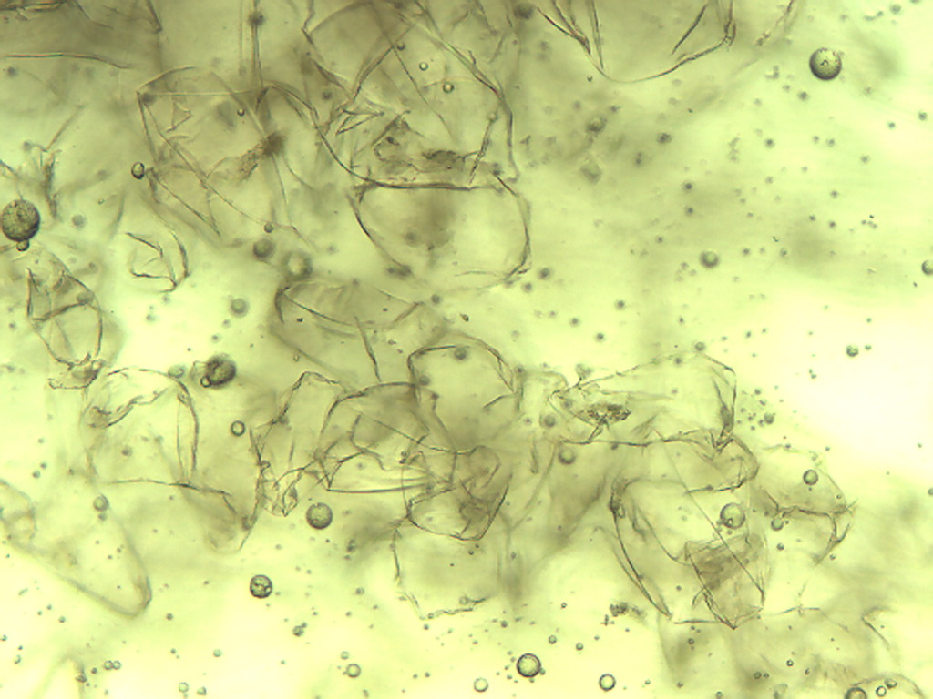
Notes:
150. Cranberry. Pulp parenchymal cells, 10X.

Slide 6
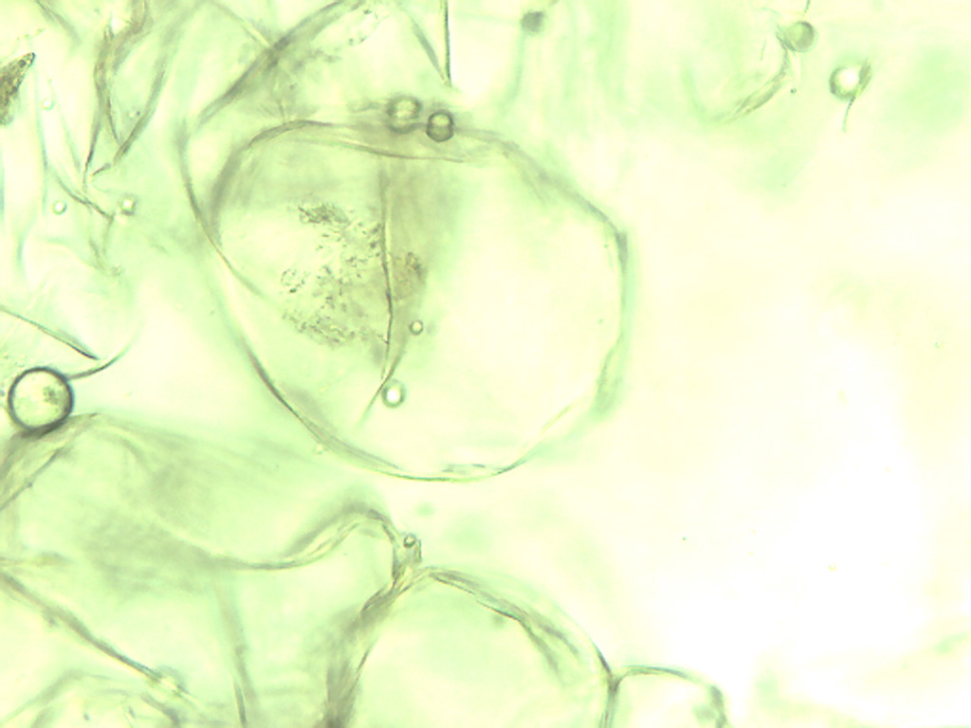
Notes:
151. Cranberry. Pulp parenchymal cell, 25X.

Slide 7
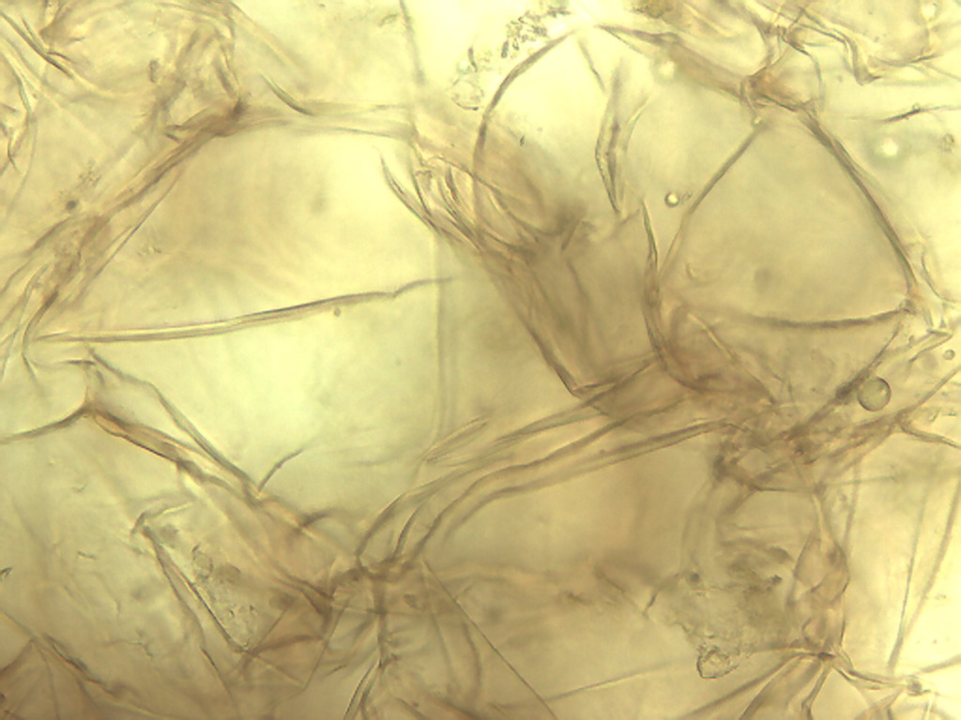
Notes:
152. Cranberry. Pulp parenchymal cells, 40X.

